Slide 1
Transport Organizer

Slide 2
Transport Organizer
It is a tool for creating, documenting and releasing transports requests.
The transaction code for transport organizer is SE09/SE10.
Transport request is a mechanism to send the objects from one system to other system.

Slide 3
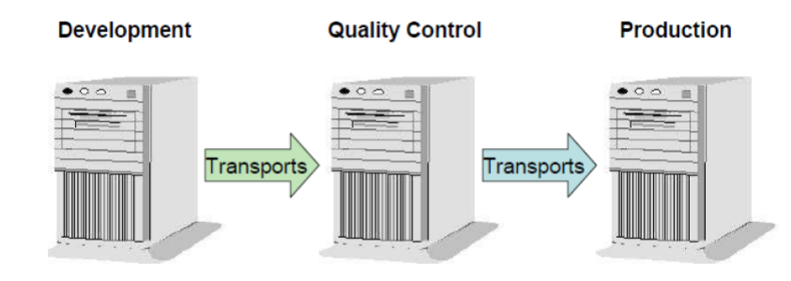
SAP System Landscape
There are 3 types of systems in SAP system landscape.
Development
Quality
Production
SAP System Landscape

Slide 4
Development System
The abbreviation DEV/CUST is used for the development system.
It is used for all developments and configurations.
The developments and configurations move from development system to quality system through a mechanism called as transport request.

Slide 5
Quality System
The abbreviation QAS/QTST is used for quality system.
The testing of all the developments and customizations needs be done in the quality system.
The developments and configurations move from quality system to production system through transport request.

Slide 6
Production System
The abbreviation PRD/PROD is used for production system.
It is also called as live system or customer based system.
Customer runs his business through production system.

Slide 7
Types of Transport Request
There are 4 types of transport request.
Workbench request
Customizing request
Transport of copies
Relocation

Slide 8
Types of Transport Request
Workbench Request : A workbench request is for carrying out development work in the ABAP workbench. This is primarily code or custom objects.
Customizing Request: The customizing request is for configuration changes in SPRO and customizing table contents.

Slide 9
Types of Transport Request(Contd.)
Transport of Copies(TOC) : It is used to transfer the changes to the other system without releasing the main transport request. After successful testing, we can release our main transport request. So, at the end we will have a single transport request for all our changes.
Relocation: We can use this request type when we want to change the development system of individual objects on a permanent basis.

Slide 10
Status of Transport Request
There are 2 status of transport request.
Modifiable
Released

Slide 11
Status of Transport Request
Modifiable - Changes still can be added or removed from the transport request. If the status is modifiable, it can not be import to another system.
Released - No more changes can be done to the transport request. The request is ready to be import to another system.

Slide 12
Operations on TR through Transport Organizer
The various operations on transport request through transport organizer are as follows:
Creation of transport request.
Changing the description of a transport request.
Adding users to a transport request.
Simulate Release a transport request.
Release a transport request.

Slide 13
Operations on TR through Transport Organizer(Contd.)
Transport logs of transport request.
Display a transport request
Adding objects to a transport request.
Deleting the objects from a transport request.
Deleting a transport request.
Moving objects from one transport request to another transport request.

Slide 14
Moving a Local Object into Customized Package and TR
The steps to move a local object into own customized package and transport request are as follows:
Go to the particular object and choose object directory entry.
(Goto-Object directory entry)
Change the package name from $TMP to customized package.
Pass the respective transport request.

Slide 15
Changing the Status of a TR from Released to Modifiable
The steps to change the status of a TR(transport request) from released to modifiable are as follows:
Execute the program - RDDIT076.
Pass the released request number.
Select the request/tasks and change the status from R(Released) to D(Modifiable).

Slide 16
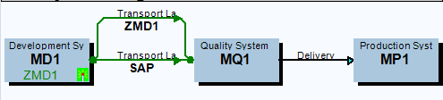
Transport Layer
Transport layer is used to establish
the path to move the objects.
SAP is a standard transport layer used
to move SAP standard objects.
Z<SID> is custom transport layer to move
the customized objects, where SID = system id.
Transport Layer in STMS( Z<SID> and SAP)

Slide 17
Transport Layer(Contd.)
A transport layer is assigned to each development class/package and thus to all the objects in that class.
The transaction code to define the transport layer and transport route is STMS(SAP Transport Management System).

Slide 18
Transport Strategies(Procedures)
The transaction code STMS_IMPORT is used to import the transport requests.
There are 2 procedures/strategies to use import queue to import the transports.
Mass Transport - To import all the requests.
Single Transport - To import a single request.

Slide 19
Important Transaction Codes
SE09/SE10 - Transport Organizer
SE03 - Transport Organizer Tools
STMS - To define the transport layer and transport route
STMS_IMPORT - To import the transports

Slide 20
Thank You

